Slide 1
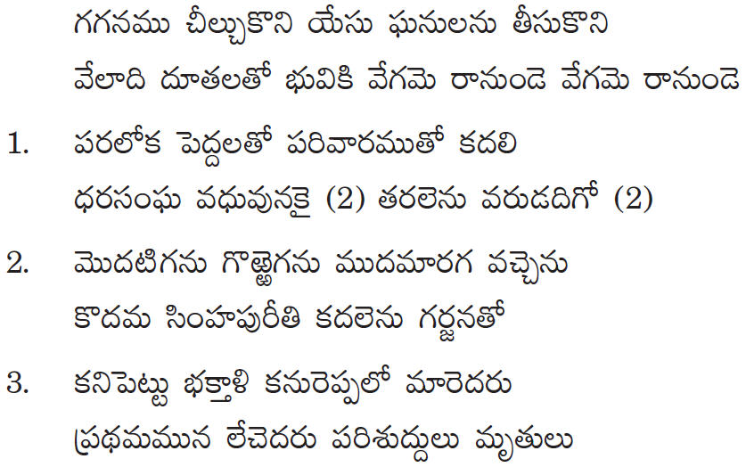
TELUGU CHRISTIAN FELLOWSHIP of MN

